Slide 1


Affiliated to Visvesvaraya Technological University BELAGAVI – 590018
Navkis College Of Engineering, Hassan
Internship Presentation(18EC185)
On
“Criminal face detection using python”
Internship Carried at
Inventeron Technologies, No-4, 3rd floor, 5th A Main Road, Adjacent to Bangalore Baptist Hospital, Hebbal Bangalore-560024,
PRESENTED BY: THEJASGOWDA M R(4YG20EC021)
Internal guide:
Mrs. Siddika Sabahath Anjum
Assistant professor
Department of E&CE
NCE, HASSAN
Under the guidance of
External guide:
Mr. MOHAMMED MISBAH
Director
Inventeron Technologies, Bengaluru
Department of Electronics and Communication Engineering
Navkis College of Engineering, Hassan – 573217
2023-2024
1

Slide 2
CONTENTS:
About the company and Department
Weekly Overview of Internship Activities(Task Performed)
Criminal face detection using python
Methodology
Flow chart
Result
Conclusion
Future work

Slide 3
About the company and Department
“Inventeron Technologies and Business Solution LLP Bangalore”
It is a core company for Embedded Electronics and Software Development. It is an Indian-based engineering and Electronics Company headquartered in Bangalore, Karnataka, India.
It is both a product and service-oriented software company having its products in wireless communication Technology and providing quality service to its valuable clients in its domain.
The company was legally registered in the year 2013, but it made its humble beginning in the year 2012 with a team of six members.
In the beginning the team started designing some protocols for wireless communication with a range of up to 4 to 5 km line of sight.

Slide 4
COMPANY STRATERGY:
• Purpose To help the mankind to achieve their goals with the growing technologies.
• Vision To provide Technology for everyone and everywhere.
• Mission To provide quality service and products at the most affordable price.
GOALS:
• To understand customer requirements and fulfill them.
• To increase the productivity and improve the more efficient in the field electronics customer service satisfaction.
• To do Innovations in Embedded Electronics and provide quality services to deliver a range of products.

Slide 5
WEEKLY OVERVIEW OF INTERNSHIP ACTIVITIES:
Week 1:
Introduction to basic concepts of Python programming.
Installation of Anaconda navigator, libraries, and Fundamental types in Python programming.
Week 2:
Session about key topics of tuples, sets, dictionaries, etc. With examples.
A brief introduction to NumPy, Pandas, Object-oriented programs, Modules, and Packages

Slide 6
Week 3:
Session about Handling missing Data with examples using Jupyter Python.
Introduction to Matplotlib library for Data analysis.
Week 4:
Projects on Driver Drowsiness detection system and Criminal detection using logistic regression.
Analysis of projects and view the valid output of these projects.

Slide 7
Criminal face detection using Python:
The face is crucial for human identity. It is the feature that best distinguishes a person. Face detection and recognition is the technology that is used to identify a person from a video or image.
face detection and recognition system for criminal identification using Python along with OpenCV package.
Most of the common facial recognition techniques include the target matching method, geometric feature recognition method, principal component analysis method, and so on.
Most of the criminals are mingled with us in our society and they are much hard to identify.
.

Slide 8
CONTINUE…
Traditionally, repeated criminals are identified by their biometrics such as thumbprint. But criminals are smart enough not to leave their biometrics at the crime scene.
In developed countries, the government creates a dataset that helps recognize the human face which compares the suspicious act with a trained dataset and information stored in a database.
The face recognition system was built by using the Principal Component Analysis (PCA) method. The two main disadvantages of using the PCA method are that computational complexity is high and it can only process faces that have similar facial expressions.
This technology is a widely used biometrics system for authentication, authorization, verification, and identification. Applying principal component analysis for finding distinguishable features from many images to get the similarity for the target image.

Slide 9
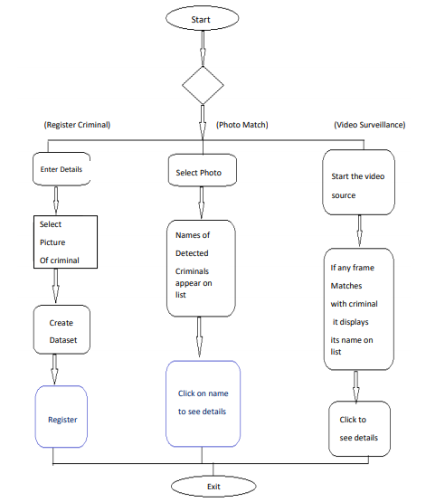
Flow chart:
Fig 1: Process flow diagram of CFIS
flow diagram of CFI

Slide 10
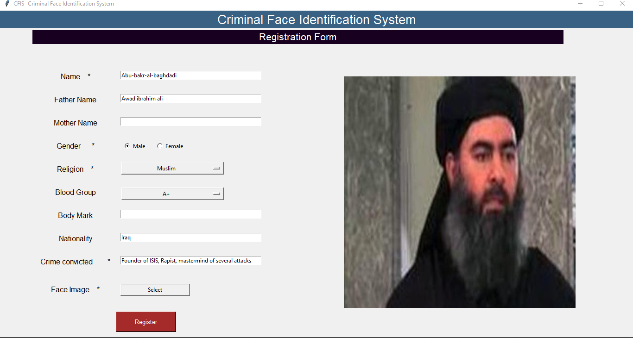
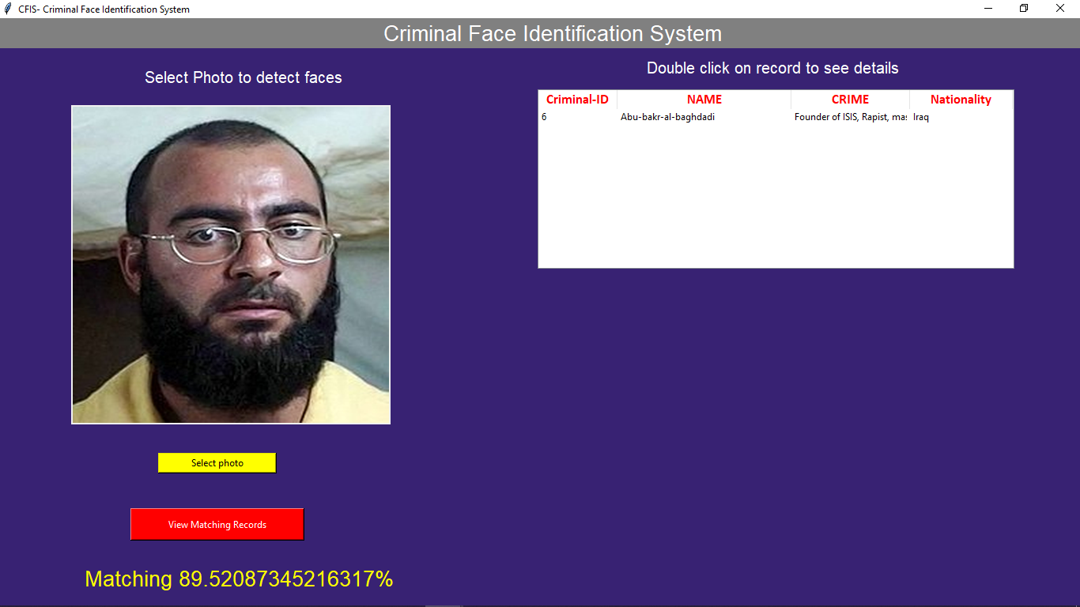
Fig 2:Register criminal Fig 3:Face Identification using photo match

Slide 11
Methodology:
In this project, we can detect and recognize the faces of criminals in a video stream obtained from a camera in real time.
The system consists of three databases. First is the citizen database, which will contain the images and unique IDs of all the citizens living in that country.
Second is the local watch list database, which will have the images(min 10) and details(Unique-id, Name, Gender, Religion, crimes done), etc. of each criminal who belongs to that country.
Third is the International Watch list database, which will have the images (min 10) and details(Unique-id, Name, Gender, Religion, Crimes done), etc. of the criminals who are not citizens of that country. All the images are first preprocessed. Then it goes through feature extraction where the Haar cascade is used.
The video is captured from the surveillance camera which is converted into frames. When a face is detected in a frame, it is preprocessed. Then it goes through feature extraction where the Haar cascade is used.

Slide 12
The features of the processed real-time image are compared with the features of processed images which are stored in the citizen database. If a match is found, it is further compared with the features of images stored in a local watch list database to identify if the person is a criminal or not.
If he is a criminal a notification is sent to the police personnel with all the details and the time for which he was under the surveillance of the camera.
If he is not a citizen of that country, it is then compared with the features of images stored in the international watch list database. If a match is found, a notification is sent to the police personnel with all the details and the time for which he was under the surveillance of the camera. If a match is not found in both the watchlists, he is innocent.

Slide 13
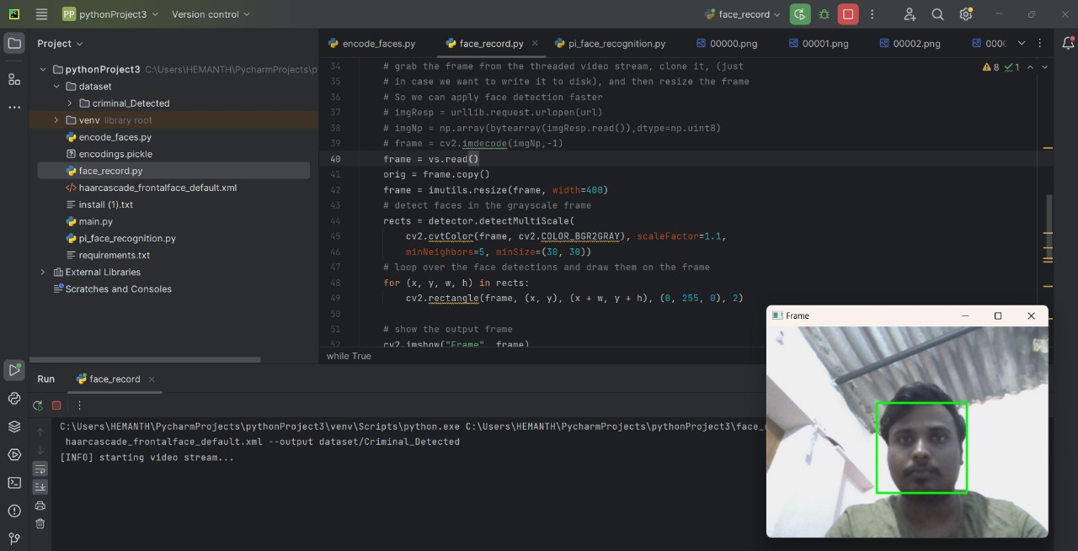
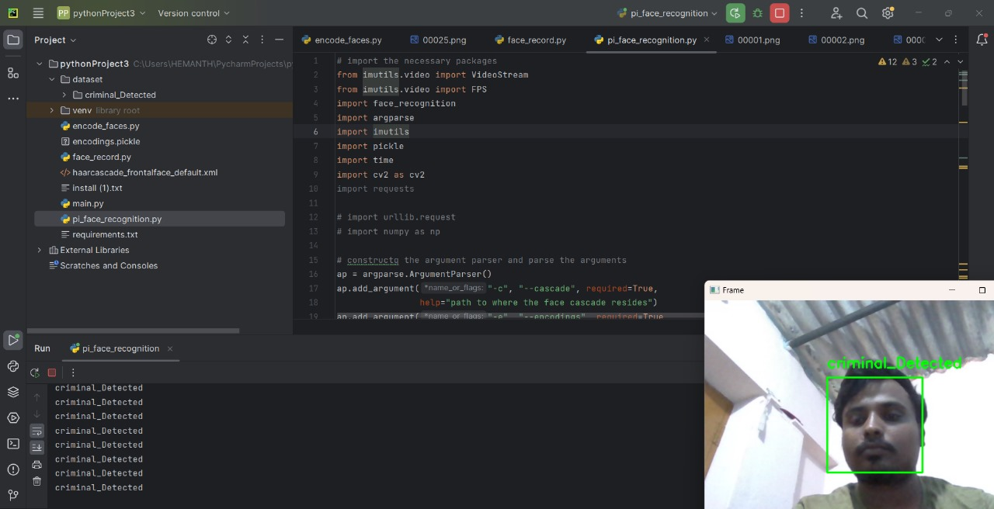
output:

Slide 14
Reflection:
During this internship we learned about the basic concepts of Python programming and their libraries and we did a project on criminal detection using Python, which helped us understand how the police use Machine Learning to identify criminals.

Slide 15
Conclusion:
In this project, we can detect and recognize the faces of the criminals in an image and a video stream. And expecting the proper working of the project in a real environment.
We have used Haar feature-based cascade classifiers in the OpenCV approach for face detection.

Slide 16
Thank You!

